Slide 1
In which events do you think that there is a risk of missing a medal in Paris based on the boats that have qualified already?

Slide 2
In which events is there a risk of missing a medal in Paris?
p(winning medal) = f(WC results from previous year + WC results from 2 years previous)
2024 Probability outputs for Team GB
2024 Probability outputs for W2-
Boat Class | Country | Medal | No medal
W4 | GBR | 41.68% | 58.32%
W2 | GBR | 4.65% | 95.35%
W4x | GBR | 53.98% | 46.02%
LW2x | GBR | 59.85% | 40.15%
M8 | GBR | 59.85% | 40.15%
M4 | GBR | 59.85% | 40.15%
M2 | GBR | 44.81% | 55.19%
M4x | GBR | 30.51% | 69.49%
Boat Class | Country | Medal | No medal
W2 | NED | 56.94% | 43.06%
W2 | ROU | 33.28% | 66.72%
W2 | AUS | 28.33% | 71.67%
W2 | IRL | 17.61% | 82.39%
W2 | USA | 15.73% | 84.27%
W2 | GBR | 4.65% | 95.35%
W2 | ESP | 3.72% | 96.28%
W2 | CZE | 1.81% | 98.19%
W2 | ITA | 0.69% | 99.31%
Notes:
Built model with assumption:
Probability of winning a medal is a function of the results at the World championships from the previous 2 years
Can only predict where a boat has been entered for the previous 2 years
Womens 8 had no entry in 2022
Chose last 2 years as first year in Olympic cycle tends to have hang overs from previous cycle
Also allows for consistency across cycles with taking COVID into account

Slide 3
How was the model built?
Scraped all WC and Olympic results from World Rowing website
Only looked at last 12 races (semi-finals or heats if no semis)
Obtained rank order from finishing positions
Percentage of winning time was average of fastest time across semi-finals and A final
Boat Class | Year | Round | Round Number | Position | Country | Time | Medalled | Winning Time | % fastest time
LW2x | 2010 | Final | A | 1 | CAN | 08:06.2 | 1 | 08:06.2 | 1
LW2x | 2010 | Final | A | 2 | GER | 08:07.3 | 1 | 08:06.2 | 0.998
LW2x | 2010 | Final | A | 3 | GRE | 08:09.1 | 1 | 08:06.2 | 0.994
LW2x | 2010 | Final | A | 4 | AUS | 08:11.2 | 0 | 08:06.2 | 0.99
LW2x | 2010 | Final | A | 5 | GBR | 08:13.9 | 0 | 08:06.2 | 0.984
LW2x | 2010 | Final | A | 6 | NZL | 08:15.7 | 0 | 08:06.2 | 0.981
LW2x | 2010 | Final | B | 7 | CHN | 07:40.5 | 0 | 08:06.2 | nan
LW2x | 2010 | Final | B | 8 | USA | 07:40.8 | 0 | 08:06.2 | nan
LW2x | 2010 | Final | B | 9 | ITA | 07:42.9 | 0 | 08:06.2 | nan
LW2x | 2010 | Final | B | 10 | BEL | 00:07:46 | 0 | 08:06.2 | nan
LW2x | 2010 | Final | B | 11 | AUT | 07:51.1 | 0 | 08:06.2 | nan
LW2x | 2010 | Final | B | 12 | ESP | 07:57.5 | 0 | 08:06.2 | nan
LW2x | 2010 | Semi | 1 | 1 | GBR | 07:34.8 | 0 | 07:34.8 | 1
LW2x | 2010 | Semi | 1 | 2 | GRE | 07:35.4 | 0 | 07:34.8 | 0.999
LW2x | 2010 | Semi | 1 | 3 | NZL | 07:36.7 | 0 | 07:34.8 | 0.996
LW2x | 2010 | Semi | 1 | 4 | USA | 07:39.8 | 0 | 07:34.8 | 0.989
LW2x | 2010 | Semi | 1 | 5 | CHN | 07:46.0 | 0 | 07:34.8 | 0.976
LW2x | 2010 | Semi | 1 | 6 | ITA | 07:49.6 | 0 | 07:34.8 | 0.968
LW2x | 2010 | Semi | 2 | 1 | CAN | 07:40.9 | 0 | 07:34.8 | 0.987
LW2x | 2010 | Semi | 2 | 2 | AUS | 07:44.0 | 0 | 07:34.8 | 0.98
LW2x | 2010 | Semi | 2 | 3 | GER | 07:45.2 | 0 | 07:34.8 | 0.978
LW2x | 2010 | Semi | 2 | 4 | BEL | 07:50.0 | 0 | 07:34.8 | 0.968
LW2x | 2010 | Semi | 2 | 5 | AUT | 07:57.0 | 0 | 07:34.8 | 0.953
LW2x | 2010 | Semi | 2 | 6 | ESP | 08:12.9 | 0 | 07:34.8 | 0.923
Notes:
Scraped results from World Championships and Olympic Games only from World rowing
Only looked at last 12 races as anyone outside top 12 was unlikely to be a medal contender
Rankings could be obtained through final finish order
Rankings do not necessarily reflect closeness of competition
Tried to create identifier to stipulate how close boats were
Times could be used for A final
How do you compare boat 6 with boat 7
Times of B final may be at a quicker time of day

Slide 4
How was the model built?
For each WC and Oly produced:
Rank order
Relative speed
Boat Class | Year | Country | % fastest time | Position | Medalled
LW2x | 2010 | CAN | 0.993 | 1 | 1
LW2x | 2010 | GER | 0.988 | 2 | 1
LW2x | 2010 | GRE | 0.996 | 3 | 1
LW2x | 2010 | AUS | 0.985 | 4 | 0
LW2x | 2010 | GBR | 0.992 | 5 | 0
LW2x | 2010 | NZL | 0.988 | 6 | 0
LW2x | 2010 | CHN | 0.976 | 7 | 0
LW2x | 2010 | USA | 0.989 | 8 | 0
LW2x | 2010 | ITA | 0.968 | 9 | 0
LW2x | 2010 | BEL | 0.968 | 10 | 0
LW2x | 2010 | AUT | 0.953 | 11 | 0
LW2x | 2010 | ESP | 0.923 | 12 | 0
Notes:
For each World championships and Olympic games, this produced:
Rank order by event
Relative speed by event

Slide 5
How was the model built?
Boat_Class | Country | Year_1 | Time_diff_1 | Position_1 | Medalled_1 | Year_2 | Time_diff_2 | Position_2 | Medalled_2 | Year_Olym | Time_diff_Olym | Position | Medalled
W4 | AUS | 2018 | 0.997 | 2 | 1 | 2019 | 0.997 | 1 | 1 | 2020 | 1 | 1 | 1
W4 | CHN | 2018 | 0.964 | 6 | 0 | 2019 | 0.988 | 9 | 0 | 2020 | 0.975 | 5 | 0
W4 | DEN | 2018 | 0.985 | 4 | 0 | 2019 | 0.987 | 3 | 1 | 2020 | 0.948 | 8 | 0
W4 | GBR | 2018 | 0.979 | 7 | 0 | 2019 | 0.986 | 7 | 0 | 2020 | 0.977 | 4 | 0
W4 | NED | 2018 | 0.99 | 8 | 0 | 2019 | 0.997 | 2 | 1 | 2020 | 0.994 | 2 | 1
W4 | POL | 2018 | 0.978 | 5 | 0 | 2019 | 0.987 | 4 | 0 | 2020 | 0.957 | 6 | 0
W4 | ROU | 2018 | 0.944 | 11 | 0 | 2019 | 0.977 | 5 | 0 | 2020 | 0.972 | 9 | 0
W4 | USA | 2018 | 1 | 1 | 1 | 2019 | 0.981 | 6 | 0 | 2020 | 0.963 | 7 | 0
Transformed data so that WC years appeared as properties of the Olympic year

Slide 6
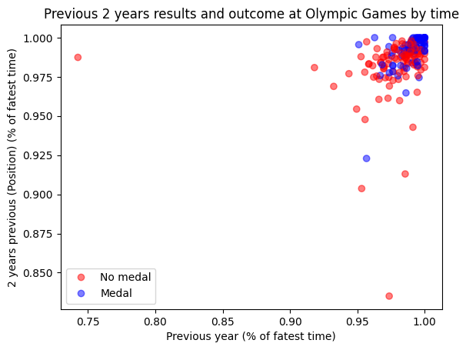
How was the model built?
Plot relative times of previous 2 years with outcome at Olympic games
Notes:
Plotted relative times of previous 2 years with outcome at Olympic games
Hypothesis was that there was some bounding box in the top right-hand corner, where if you were within that box, it meant a medal was more likely.

Slide 7
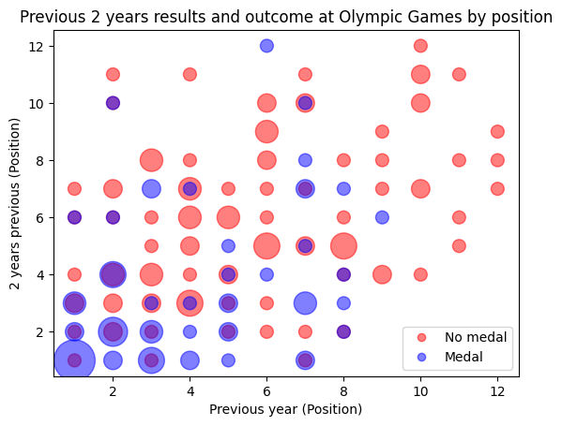
How was the model built?
Plot position of previous 2 years with outcome at Olympic games
Size of dot represents number of occurrences
Notes:
Did same exercise with finishing positions.
Hypothesis was that there was some bounding box in the bottom left corner, where if you were within that box, it meant a medal was more likely.

Slide 8
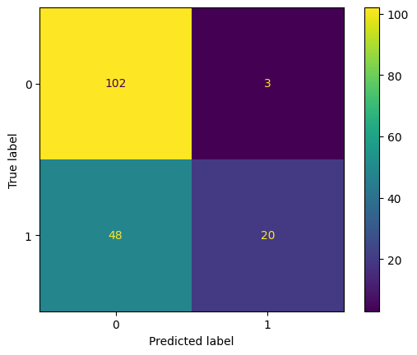
How was the model built?
Logistic Regression confusion matrix
Built binary classifier Logistic Regression model
Labels:
1 = Win medal at OC
0 = No medal
Added class weighting as uneven sample set
Used rank positions as returned better fit
Built using entire data set
Probably overfitted!
Notes:
Built binary classifier Logistic regression model
Binary classifier for 1 = win medal
Tried Naïve Bayes but logistic regression gave better results
Built on entire model
Did not have time to do train/test split
Probably overfitted
Recall is not good – not picking up a lot of medals won

Slide 9
How could model be improved?
Are boats in previous years a fair reflection on current boats?
If model was built on relative speed, it could return how much quicker a boat needs to go.
How do you measure relative speed?
Accommodate changes in conditions
Should relative speed be based on a logarithmic scale?
Is it possible to include intermediate race results?
e.g., World Cups and European Champs.
Notes:
Are boats in previous years a fair reflection on current boats
What happens when personnel change
If model was built on relative speed, it could return how much quicker a boat needs to go.
How do you measure relative speed?
Accommodate changes in conditions
Should relative speed be based on a logarithmic scale?
Gaps get smaller in a tail wind
If the model included intra-season races, would it be possible to see how quick boats are going during the season

